Slide 1
Rolling Horizon Evolutionary Algorithms IGGI Game Design II
Simon Lucas, Jialin Liu and Diego Perez
Game AI Research Group
Queen Mary University of London
Notes:
Hi, I’m Simon Lucas, welcome to my short video about general AI with statistical forward planning algorithms

Slide 2
Outline
The basic idea of Rolling Horizon Evolutionary Algorithms
A particular setup and parameterization
Implementation in a Game Playing Agent
Optimising performance

Slide 3
RHEA: Type of Statistical Simulation based AI
Relies on fast forward model:
Aim to run this around 2,000 ticks per decision
F(s,a)-> s’

Slide 4
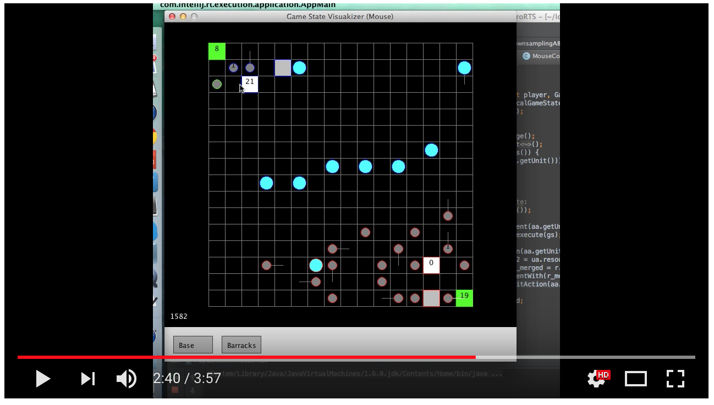
microRTS (CIG 2018) – another excellent challenge – branching factor of around 50,000 (CMABs look good for this)

Slide 5
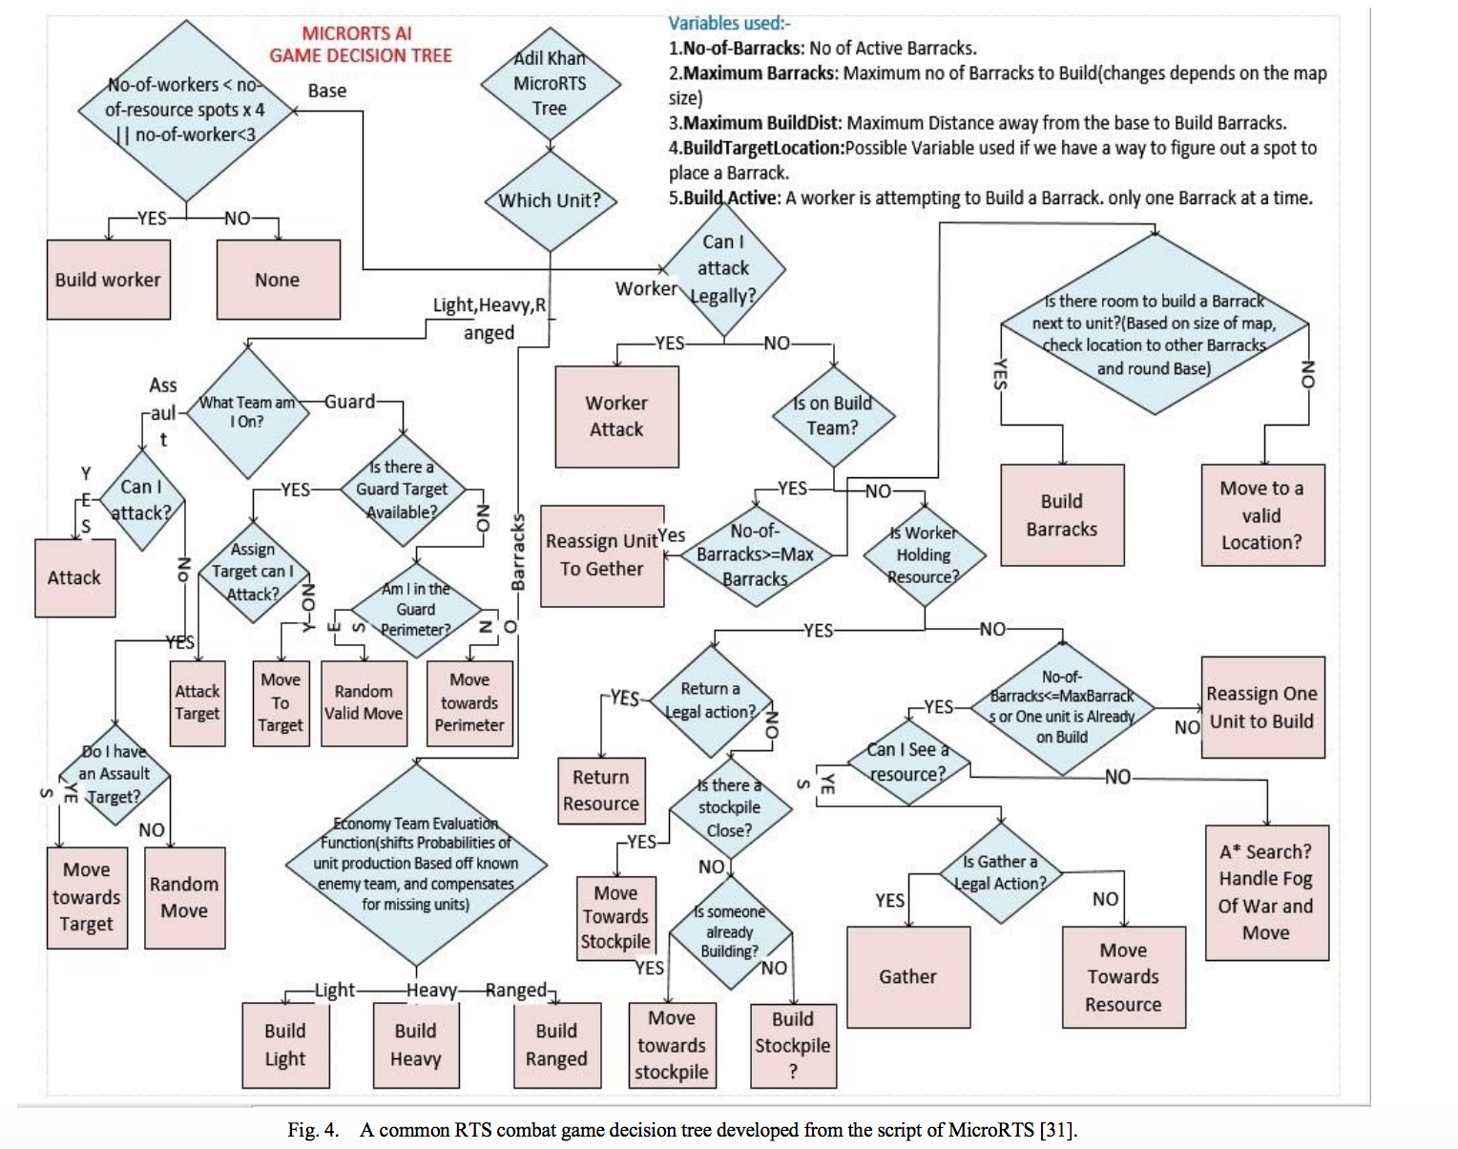
Best approach? Hand-coded versus Evo / Deep RL / ?

Slide 6
What you need to implement: (repeated from intro)
public interface AbstractGameState { AbstractGameState copy(); AbstractGameState next(int[] actions); int nActions(); double getScore(); boolean isTerminal(); }
Notes:
Here’s what you need to do to add this magic AI to your game or system: the ones to be careful with are copy and next

Slide 7
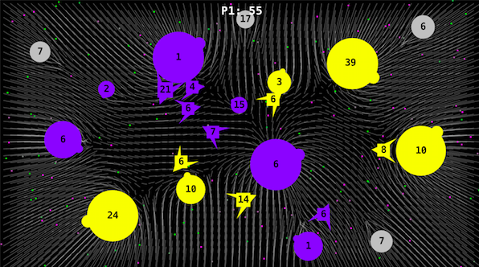
Copy state (20), copy-mutate seq(20), run (20 x 100), score (20), play, shift, repeat
93 [2, 17, 1, 11, 7, 5, 14, 8, 2, 12, 16, 1, 15, 7, 2, 3, 13, 2, 2, 10, 2, 12, 17, 2, 13, 11, 4, 13, 16, 13, 11, 17, 9, 7, 3, 9, 15, 7, 3, 11, 15, 10, 2, 11, 15, 4, 11, 15, 13, 13, 15, 13, 12, 9, 4, 17, 11, 4, 8, 16, 17, 0, 7, 17, 16, 7, 8, 16, 9, 16, 5, 14, 2, 5, 14, 16, 5, 14, 8, 6, 1, 14, 9, 13, 17, 13, 0, 17, 0, 2, 16, 6, 8, 16, 7, 7, 1, 2, 15, 5, 0, 0, 4, 10, 5, 8, 11, 3, 13, 15, 2, 13, 5, 9, 3, 0, 5, 15, 13, 3, 6, 15, 11, 12, 16, 10, 8, 12, 15, 17, 14, 2, 7, 5, 8, 2, 10, 5, 4, 13, 14, 1, 2, 1, 15, 4, 7, 3, 15, 15, 16, 3, 11, 12, 4, 11, 2, 17, 15, 9, 1, 0, 9, 15, 16, 8, 4, 12, 7, 16, 11, 6, 4, 8, 10, 4, 7, 17, 17, 9, 5, 10, 16, 11, 4, 8, 7, 1, 1, 13, 5, 4, 12, 15, 8, 13, 13, 13, 13, 13]
eval
copy
472 [2, 17, 1, 11, 7, 5, 14, 8, 2, 12, 15, 1, 15, 7, 2, 3, 13, 2, 2, 10, 2, 12, 17, 2, 13, 11, 4, 13, 16, 13, 11, 17, 9, 7, 3, 9, 15, 7, 3, 11, 15, 10, 2, 11, 15, 4, 11, 15, 13, 13, 15, 13, 12, 9, 4, 17, 11, 4, 8, 16, 17, 0, 7, 17, 16, 7, 8, 16, 9, 16, 5, 14, 2, 5, 14, 16, 5, 14, 8, 6, 15, 14, 9, 13, 17, 13, 0, 17, 0, 2, 16, 6, 8, 16, 7, 7, 1, 2, 15, 5, 0, 0, 4, 10, 5, 8, 11, 3, 13, 15, 2, 13, 5, 9, 3, 5, 5, 15, 13, 3, 6, 15, 11, 12, 16, 10, 3, 12, 15, 17, 14, 2, 7, 5, 8, 2, 10, 5, 4, 13, 14, 1, 2, 1, 15, 4, 7, 3, 15, 15, 16, 3, 11, 7, 4, 11, 2, 17, 15, 9, 1, 0, 9, 15, 16, 8, 4, 12, 7, 16, 11, 6, 4, 8, 10, 4, 7, 17, 17, 9, 5, 10, 16, 11, 4, 8, 7, 1, 1, 13, 5, 4, 12, 15, 8, 13, 13, 13, 13, 13]
eval
copy

Slide 8
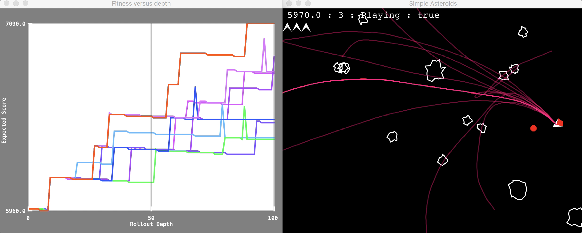
Rolling Horizon Evolution in Asteroids (each number corresponds to a joystick action)

Slide 9
Copy state (20), copy-mutate seq(20), run (20 x 100), score (20), play, shift, repeat
93 [2, 17, 1, 11, 7, 5, 14, 8, 2, 12, 16, 1, 15, 7, 2, 3, 13, 2, 2, 10, 2, 12, 17, 2, 13, 11, 4, 13, 16, 13, 11, 17, 9, 7, 3, 9, 15, 7, 3, 11, 15, 10, 2, 11, 15, 4, 11, 15, 13, 13, 15, 13, 12, 9, 4, 17, 11, 4, 8, 16, 17, 0, 7, 17, 16, 7, 8, 16, 9, 16, 5, 14, 2, 5, 14, 16, 5, 14, 8, 6, 1, 14, 9, 13, 17, 13, 0, 17, 0, 2, 16, 6, 8, 16, 7, 7, 1, 2, 15, 5, 0, 0, 4, 10, 5, 8, 11, 3, 13, 15, 2, 13, 5, 9, 3, 0, 5, 15, 13, 3, 6, 15, 11, 12, 16, 10, 8, 12, 15, 17, 14, 2, 7, 5, 8, 2, 10, 5, 4, 13, 14, 1, 2, 1, 15, 4, 7, 3, 15, 15, 16, 3, 11, 12, 4, 11, 2, 17, 15, 9, 1, 0, 9, 15, 16, 8, 4, 12, 7, 16, 11, 6, 4, 8, 10, 4, 7, 17, 17, 9, 5, 10, 16, 11, 4, 8, 7, 1, 1, 13, 5, 4, 12, 15, 8, 13, 13, 13, 13, 13]
eval
copy
472 [2, 17, 1, 11, 7, 5, 14, 8, 2, 12, 15, 1, 15, 7, 2, 3, 13, 2, 2, 10, 2, 12, 17, 2, 13, 11, 4, 13, 16, 13, 11, 17, 9, 7, 3, 9, 15, 7, 3, 11, 15, 10, 2, 11, 15, 4, 11, 15, 13, 13, 15, 13, 12, 9, 4, 17, 11, 4, 8, 16, 17, 0, 7, 17, 16, 7, 8, 16, 9, 16, 5, 14, 2, 5, 14, 16, 5, 14, 8, 6, 15, 14, 9, 13, 17, 13, 0, 17, 0, 2, 16, 6, 8, 16, 7, 7, 1, 2, 15, 5, 0, 0, 4, 10, 5, 8, 11, 3, 13, 15, 2, 13, 5, 9, 3, 5, 5, 15, 13, 3, 6, 15, 11, 12, 16, 10, 3, 12, 15, 17, 14, 2, 7, 5, 8, 2, 10, 5, 4, 13, 14, 1, 2, 1, 15, 4, 7, 3, 15, 15, 16, 3, 11, 7, 4, 11, 2, 17, 15, 9, 1, 0, 9, 15, 16, 8, 4, 12, 7, 16, 11, 6, 4, 8, 10, 4, 7, 17, 17, 9, 5, 10, 16, 11, 4, 8, 7, 1, 1, 13, 5, 4, 12, 15, 8, 13, 13, 13, 13, 13]
eval
copy

Slide 10
Rolling Horizon Evolution in Asteroids (each number corresponds to a joystick action)

Slide 11
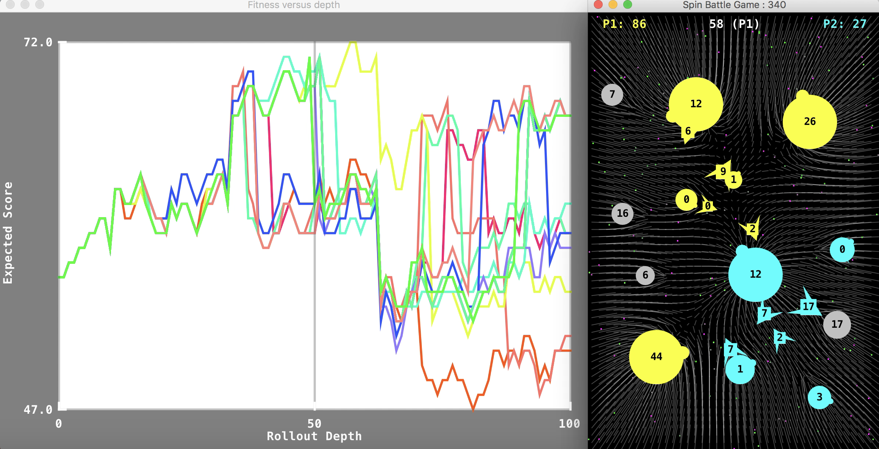
Rolling Horizon Evolution in Planet Wars (each number-pair specifies source and target planets for fleet transits)

Slide 12
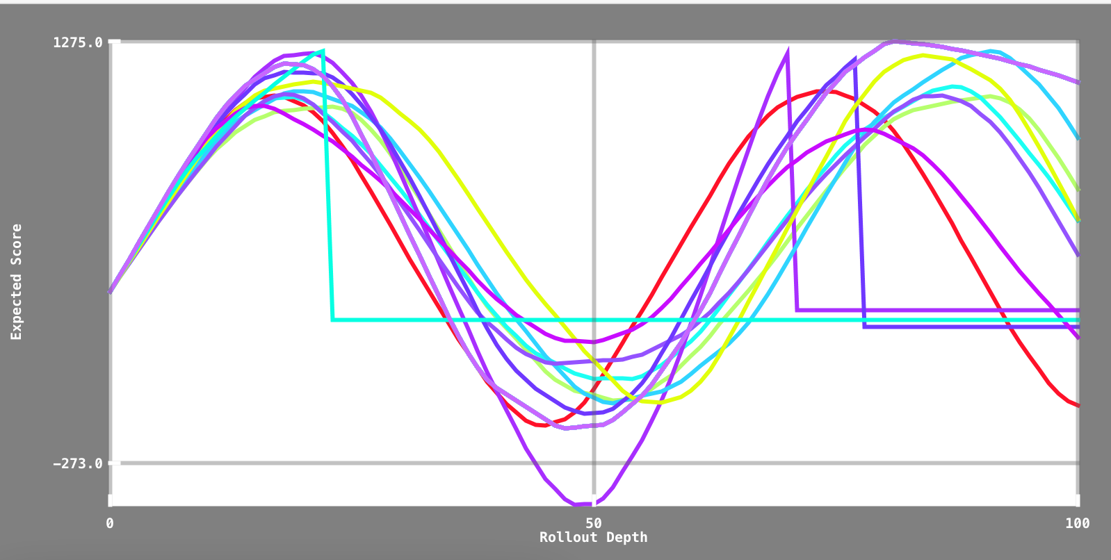
Interesting to Observe the Rollout Score Traces – what does this tell you about Cave Swing?

Slide 13
Basic Evolutionary Algorithms
Initialise (pick random points in space)
Evaluate (not part of the algorithm, but must be done)
Select Best
Vary them and go back to Evaluate if budget permits

Slide 14
My Favourite Evolutionary Algorithm Random Mutation Hill-Climber (RHMC)
Ultra-simple
Performance very good across a range of problems
Prone to get stuck in local optima
So run with random restarts or allow Large Mutations
AKA: (1+1) ES
Especially when optimising a vector of real numbers

Slide 15
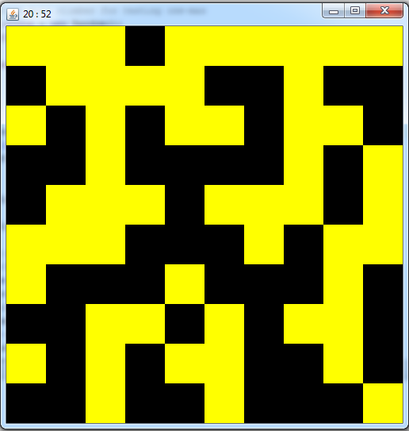
Visualisation: Demo Code for OneMax Problem solved when all grid is yellow

Slide 16
The Algorithm
Make a random solution – call it bestYet
Repeat until termination
mutatedCopy := copyAndMutate(bestYet)
If (mutatedCopy is better than bestYet)
bestYet := mutatedCopy
Terminate if bestYet is good enough
OR we’ve run out of time
Question: where is the fitness evaluation done?

Slide 17
RHMC Algorithm (for vector of real, co-evolution)
public double[] run(int nEvals) { for (int i=0; i<nEvals; i++) { // randomly mutate the best yet double[] mut = randMut(bestYet, stepFac); double diff = eval.pointsDiff(bestYet, mut); if (diff >= 0) { bestYet = mut; } } return bestYet; }

Slide 18
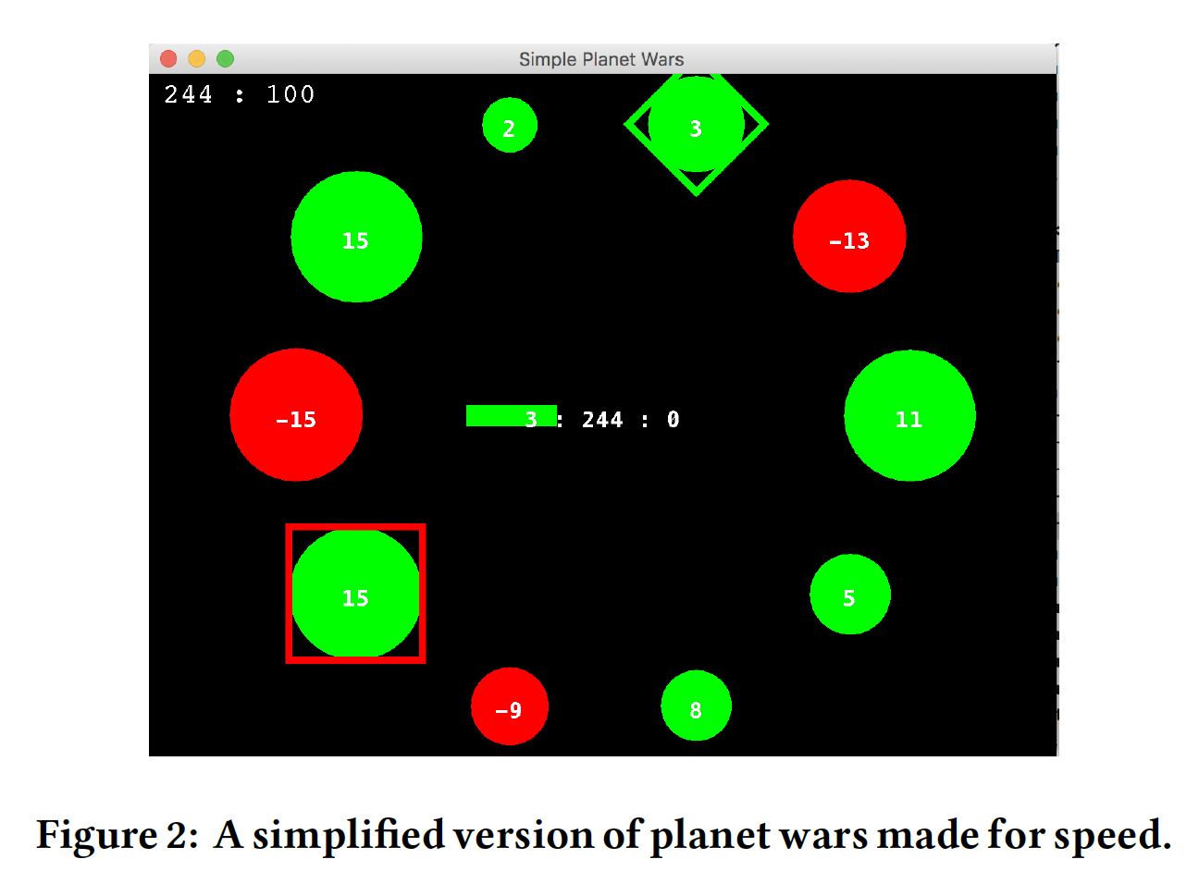
Experiments with a cut-down Planet Wars
Notes:
Uses the concept of a focus and a buffer

Slide 19
The algorithm implementation
Uses an EvoAgent class
EvoAgent implements SimplePlayerInterface
This is to allow games to deal with agents in very general ways
Decouples the evolutionary algorithm from it’s binding to the agent
Any evolutionary algorithm which implements the EvoAlg interface can be plugged in

Slide 20
Simple Player Interface
public interface SimplePlayerInterface { int getAction(AbstractGameState gameState, int playerId); SimplePlayerInterface reset(); }

Slide 21
Making an Evolutionary Agent
public static SimplePlayerInterface getEvoAgent() { int nResamples = 1; DefaultMutator mutator = new DefaultMutator(null); // setting to true may give best performance // mutator.totalRandomChaosMutation = true; mutator.flipAtLeastOneValue = true; mutator.pointProb = 5; SimpleRMHC simpleRMHC = new SimpleRMHC(); simpleRMHC.setSamplingRate(nResamples); simpleRMHC.setMutator(mutator); EvoAlg evoAlg = simpleRMHC; // evoAlg = new SlidingMeanEDA(); int nEvals = 20; int seqLength = 100; EvoAgent evoAgent = new EvoAgent().setEvoAlg(evoAlg, nEvals).setSequenceLength(seqLength); evoAgent.setDimension(new Dimension(800, 400)); evoAgent.setUseShiftBuffer(true); if (showEvolution) evoAgent.setVisual(); return evoAgent; }

Slide 22
The getAction method of EvoAgent
public int[] getActions(AbstractGameState gameState, int playerId) { searchSpace = new RegularSearchSpace(sequenceLength, gameState.nActions()); simpleGameAdapter = new SimpleGameAdapter().setEvaluator(actionSequencer).setSearchSpace(searchSpace); actionSequencer.setGameState(gameState.copy()).setPlayerId(playerId).setOpponent(opponent); actionSequencer.playoutPlotter = playoutPlotter; playoutPlotter.reset(); if (solution != null) { solution = SearchSpaceUtil.shiftLeftAndRandomAppend(solution, searchSpace); evoAlg.setInitialSeed(solution); } simpleGameAdapter.reset(); solution = evoAlg.runTrial(simpleGameAdapter, nEvals); playoutPlotter.plotPlayout(); // System.out.println(Arrays.toString(solution) + "\t " + game.evaluate(solution)); int[] tmp = solution; // already return the first element, so now set it to 1 ... if (!useShiftBuffer) solution = null; return tmp; }
Notes:
Handles calls to the plot routine, and also shift buffer

Slide 23
Action Sequencer: actVersusAgent
public ActionSequencer actVersusAgent(int[] seq, int playerId) { // careful, this may not be copiing the game state ... terminalState = initialState.copy(); playoutPlotter.startPlayout(terminalState.getScore()); int[] actions = new int[2]; for (int a : seq) { actions[playerId] = a; actions[1 - playerId] = opponent.getAction(terminalState, 1-playerId); terminalState.next(actions); playoutPlotter.addScore(terminalState.getScore()); } // System.out.println("Terminal score: " + terminalState.getScore()); playoutPlotter.plotPlayout(); return this; }

Slide 24
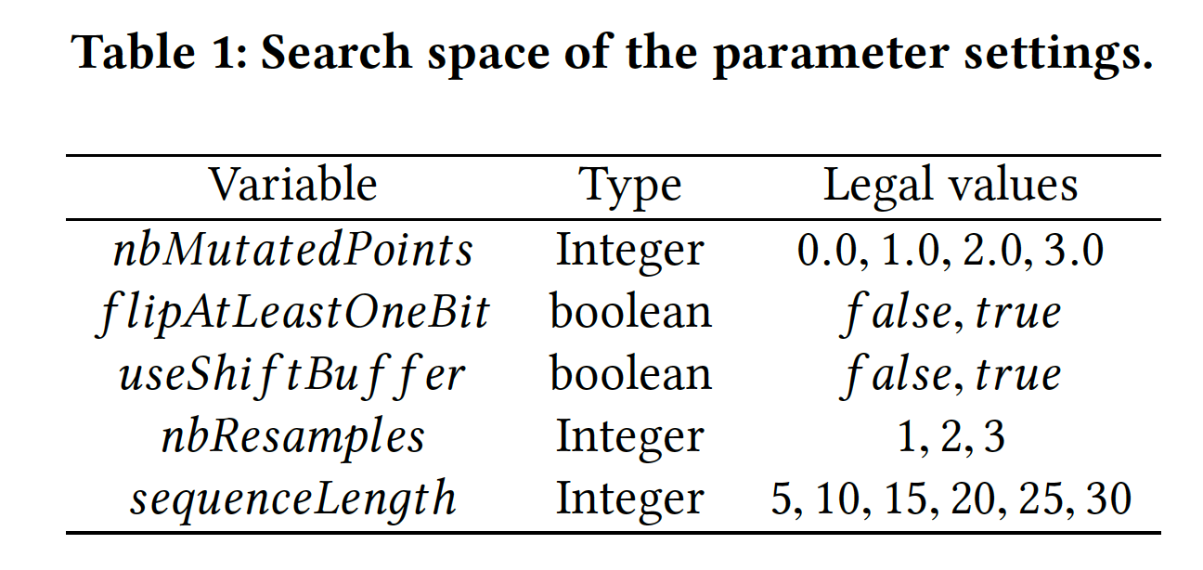
Tuning RHEA with the NTBEA: The Parameter Space

Slide 25
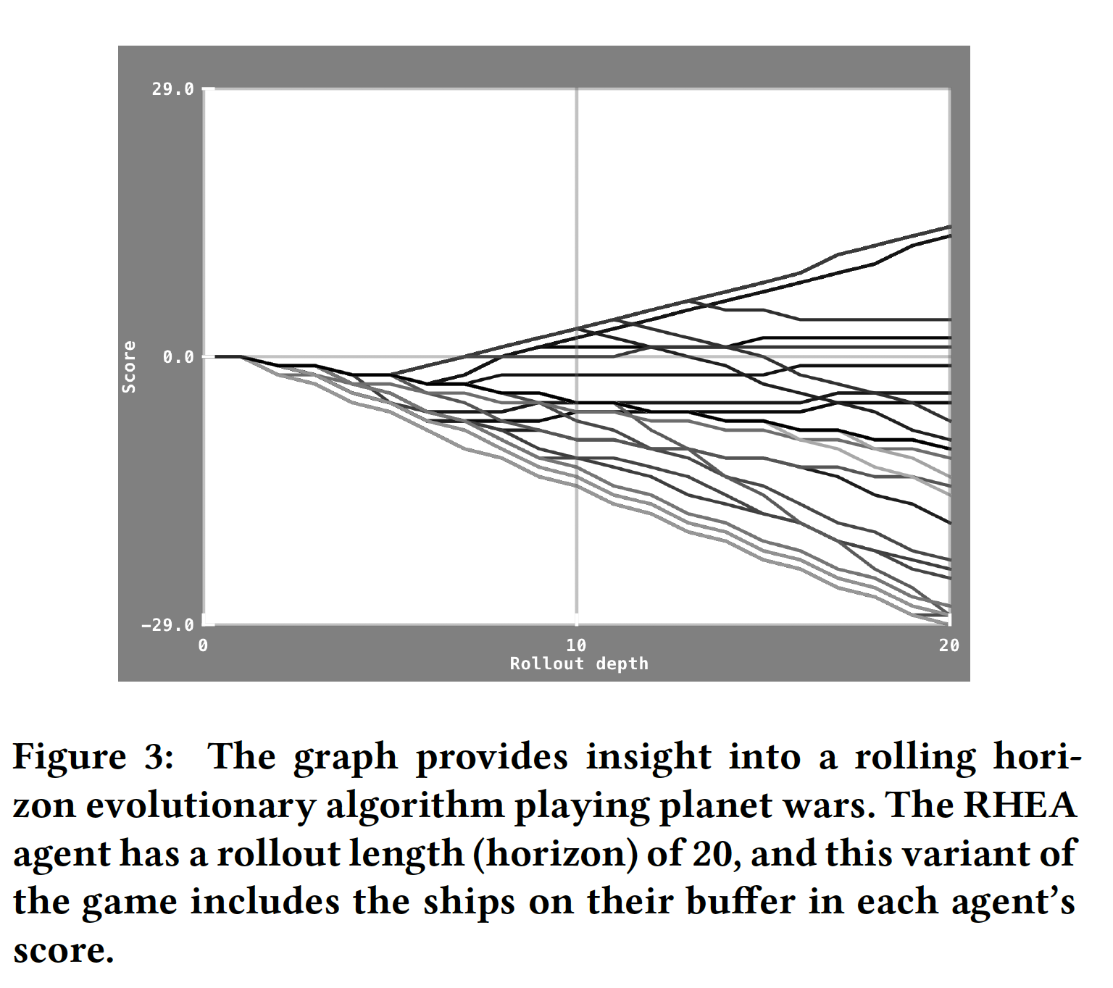
Plotting game score versus position in rollout (action sequence) – buffers included

Slide 26
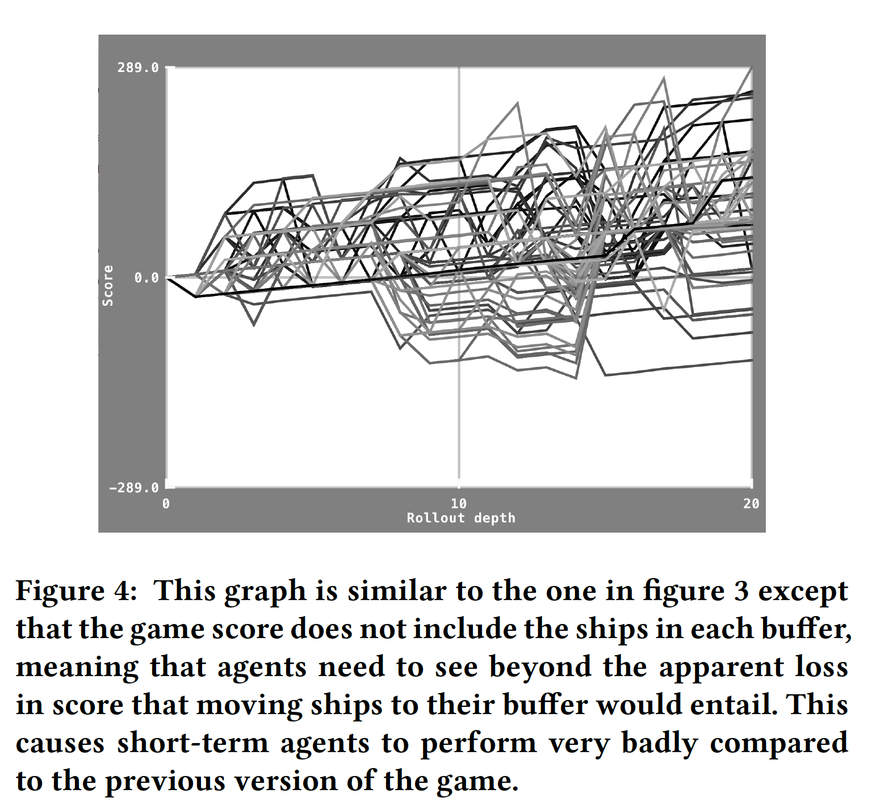
Plotting game score versus position in rollout (action sequence) – buffers not included

Slide 27
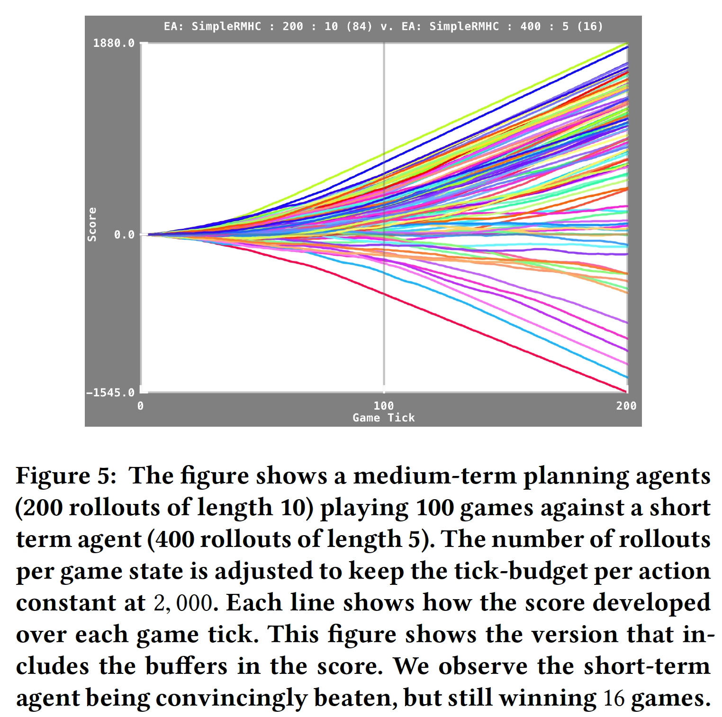
Score versus Game Tick (buffers included)

Slide 28
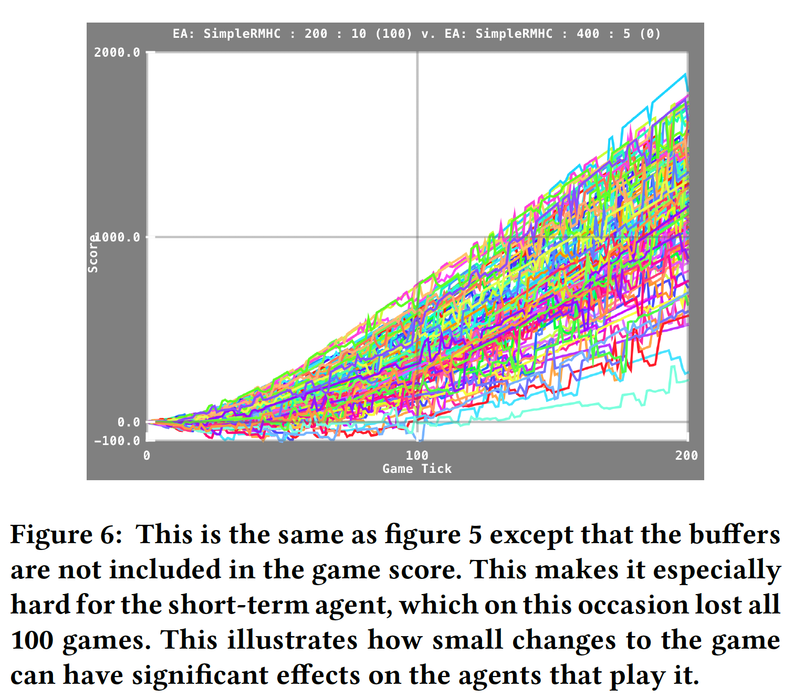
Score versus Game Tick (buffers not included)

Slide 29
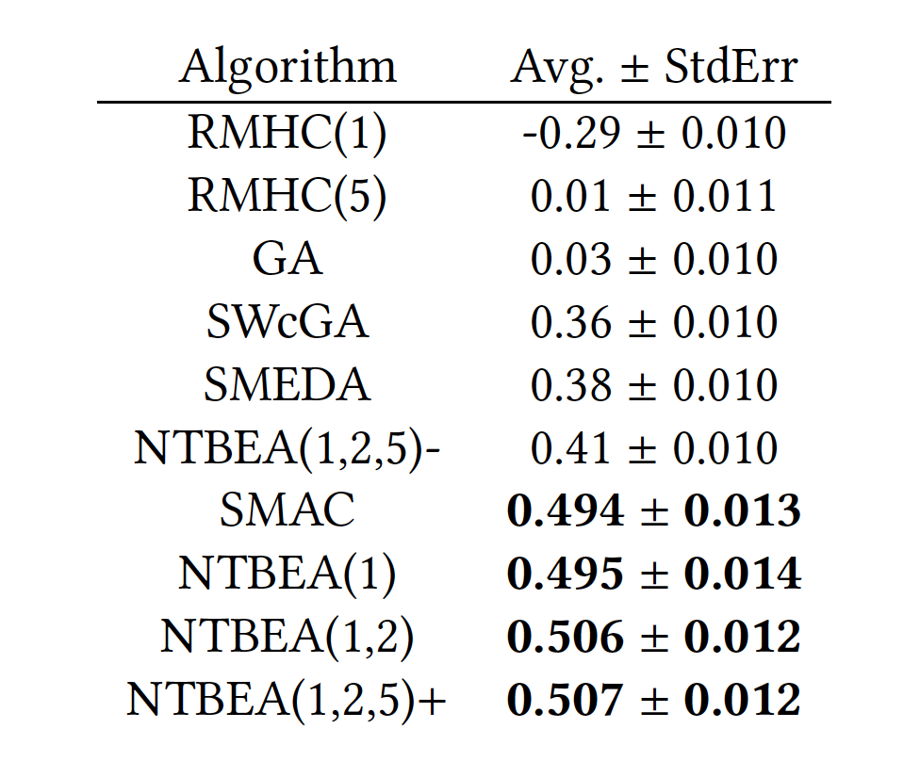
Results of various optimisation algorithms
Model based

Slide 30
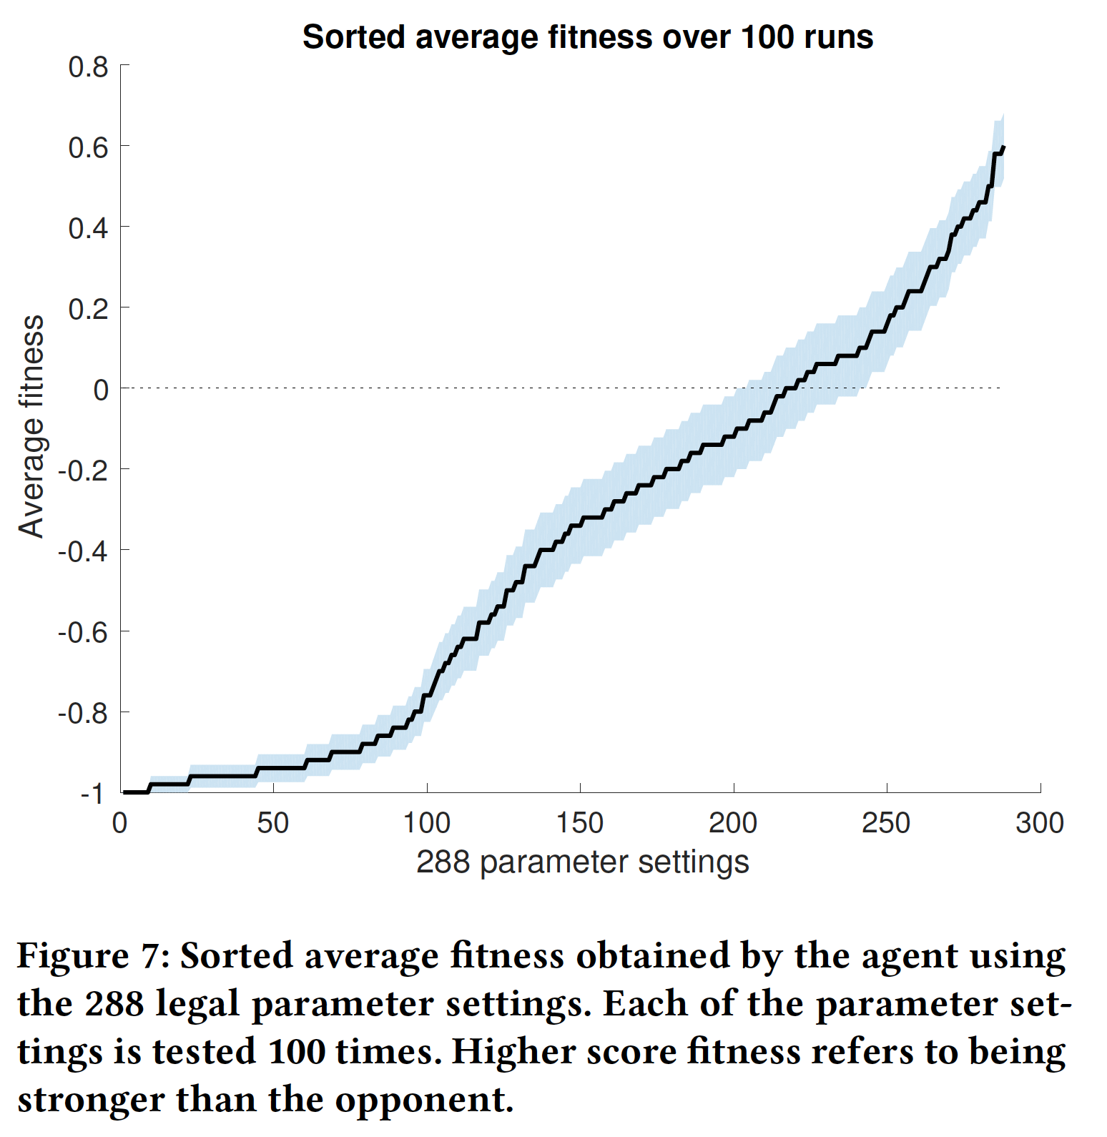
Exploring the Parameter Space Exhaustively What does this say about the game?

Slide 31
So What is New?
We’ve been playing with RHEA for a few years now
But recently:
Have tuned it better
Use long rollouts when needed
Length > 200 may be good
Normally MUCH better to use a shift buffer
Often good to use large mutation strength

Slide 32
Dealing with Flat Reward Landscapes
Enforcing Exploration
Any idea what approach you would take?
See recent work by DeepMind on Montezuma’s Revenge
Alternative approach:
Bias the rollouts / action sequences

Slide 33
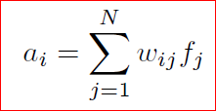
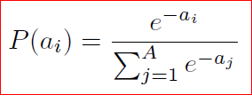
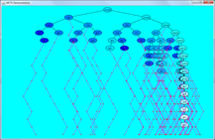
Biasing Roll-Outs
Define features to extract from each game state (f vector below)
Aim for simplicity and efficiency
Could be hand-designed or auto-generated
Then sample from Gibbs / Softmax distribution
Learn matrix W
Fast Evo MCTS
S -> F -> P(a)
Fit Vector Source

Slide 34
Mountain Car Example
Car needs to reach top of hill on right
Engine too weak too overcome gravity
Need to oscillate a bit
Vanilla MCTS fails on this!
Why?

Slide 35
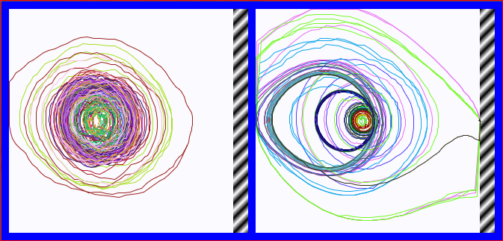
State Space Trajectories (goal is hatched area)
Left: uniform random
Right: biased – features, just the state space
These are random bias vectors: some are worse, but some are much better than uniform

Slide 36
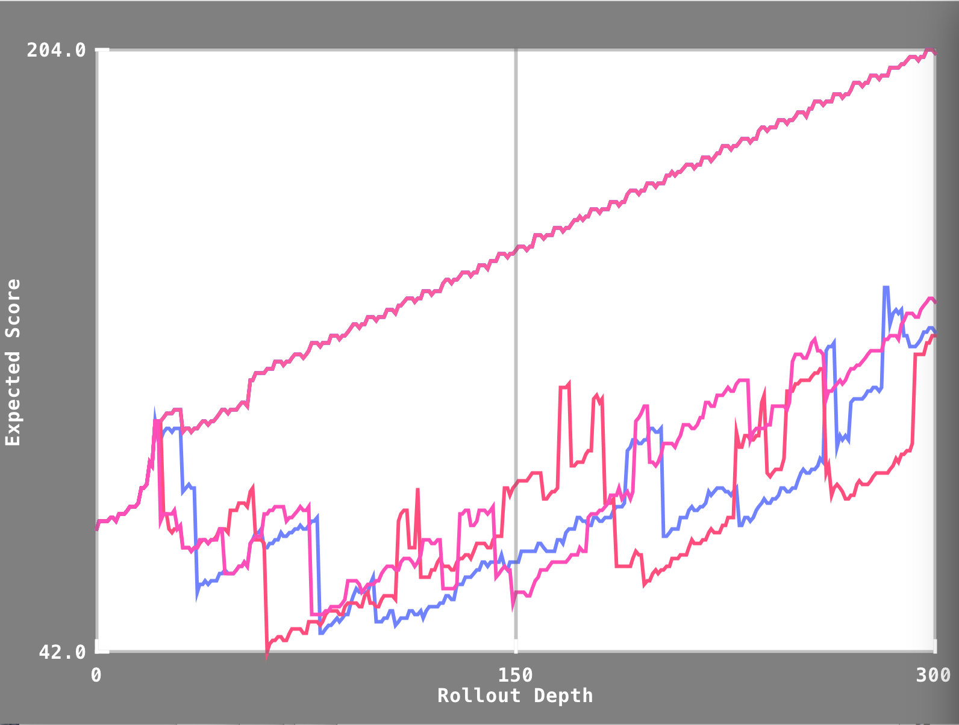
Observed Pathologies: Complacency (and Despair)
Notes:
Explain what they are and how them may be fixed …

Slide 37
Further references
Rolling horizon evolution versus tree search for navigation in single-player real-time games, D Perez, S Samothrakis, S Lucas, P Rohlfshagen, Proceedings of the 15th annual conference on Genetic and evolutionary computation (GECCO)
Rolling horizon methods for games with continuous states and actions, S Samothrakis, SA Roberts, D Perez, SM Lucas, 2014 IEEE Conference on Computational Intelligence and Games (CIG), 1-8
Analysis of vanilla rolling horizon evolution parameters in general video game playing, RD Gaina, J Liu, SM Lucas, D Pérez-Liébana, European Conference on the Applications of Evolutionary Computation, 418-434
Rolling horizon evolution enhancements in general video game playing, RD Gaina, SM Lucas, D Perez-Liebana, Computational Intelligence and Games (CIG), 2017 IEEE Conference on, 88-95
See our Google Scholar Profiles for more

